Slide 1

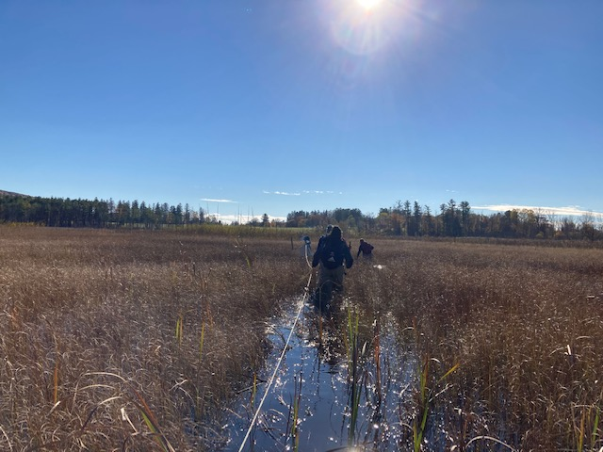
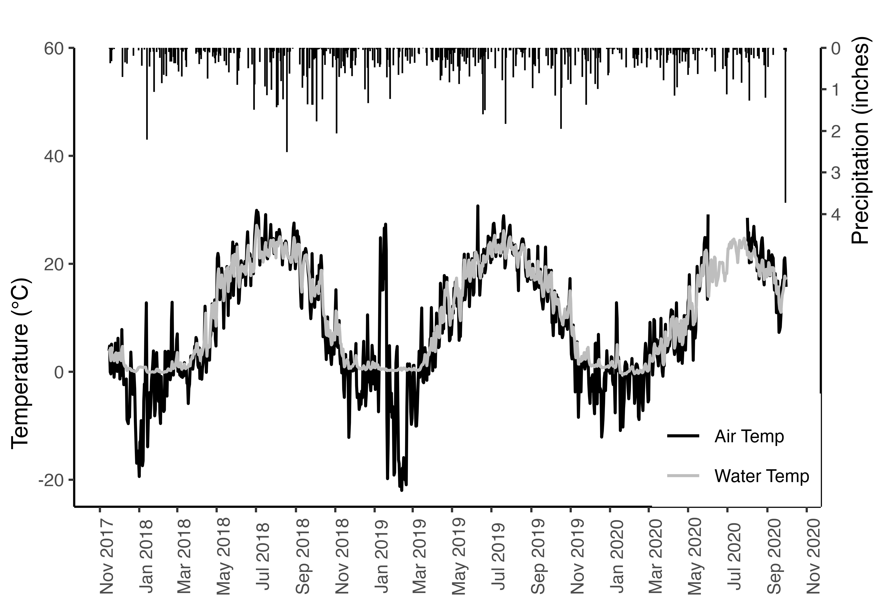
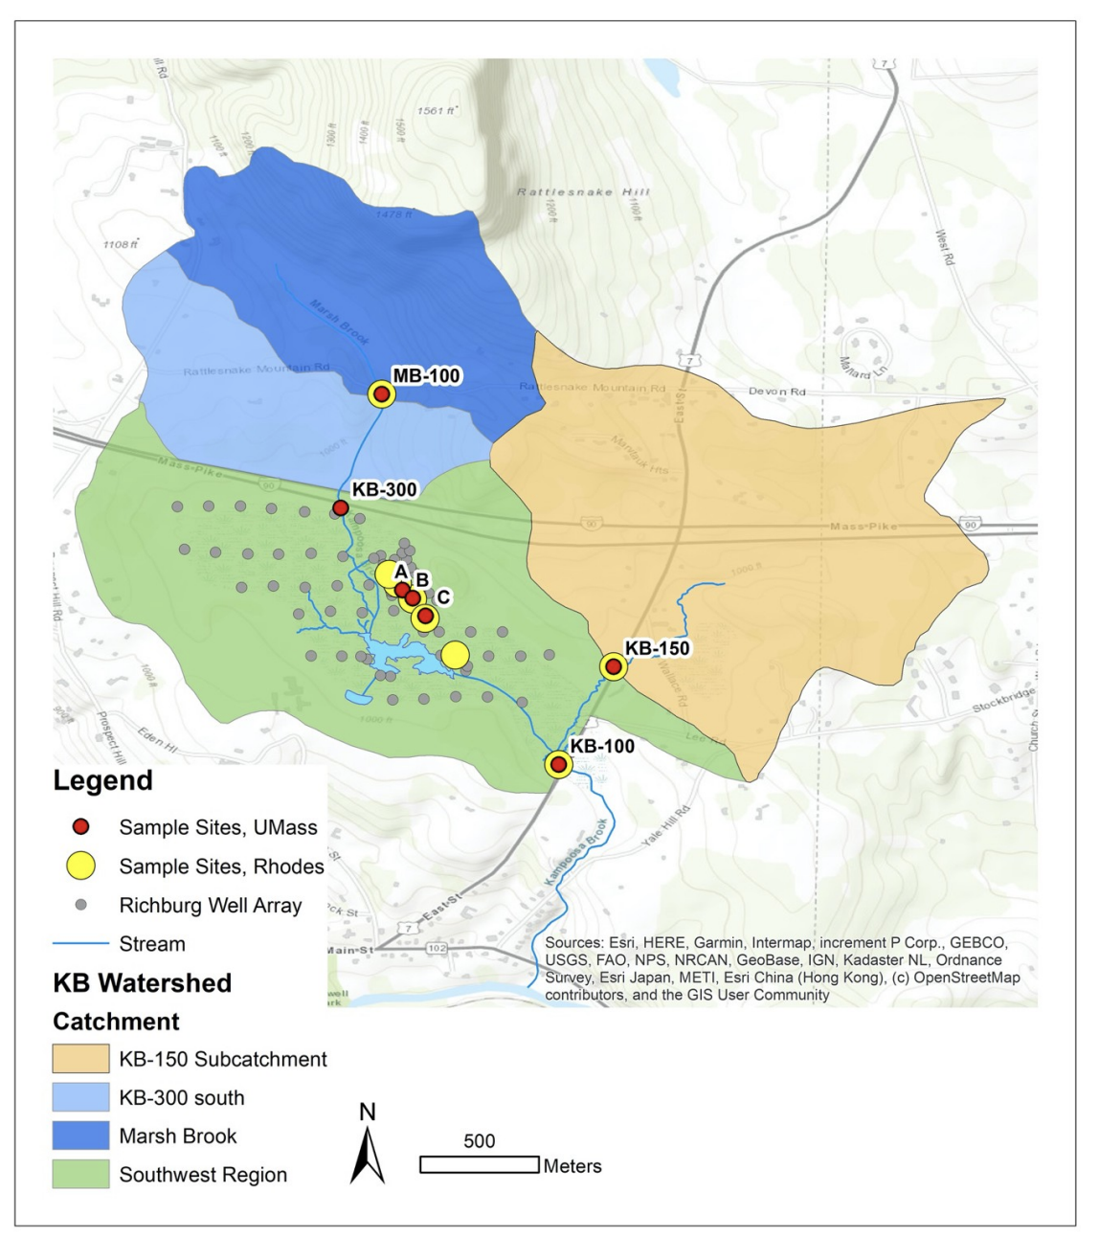
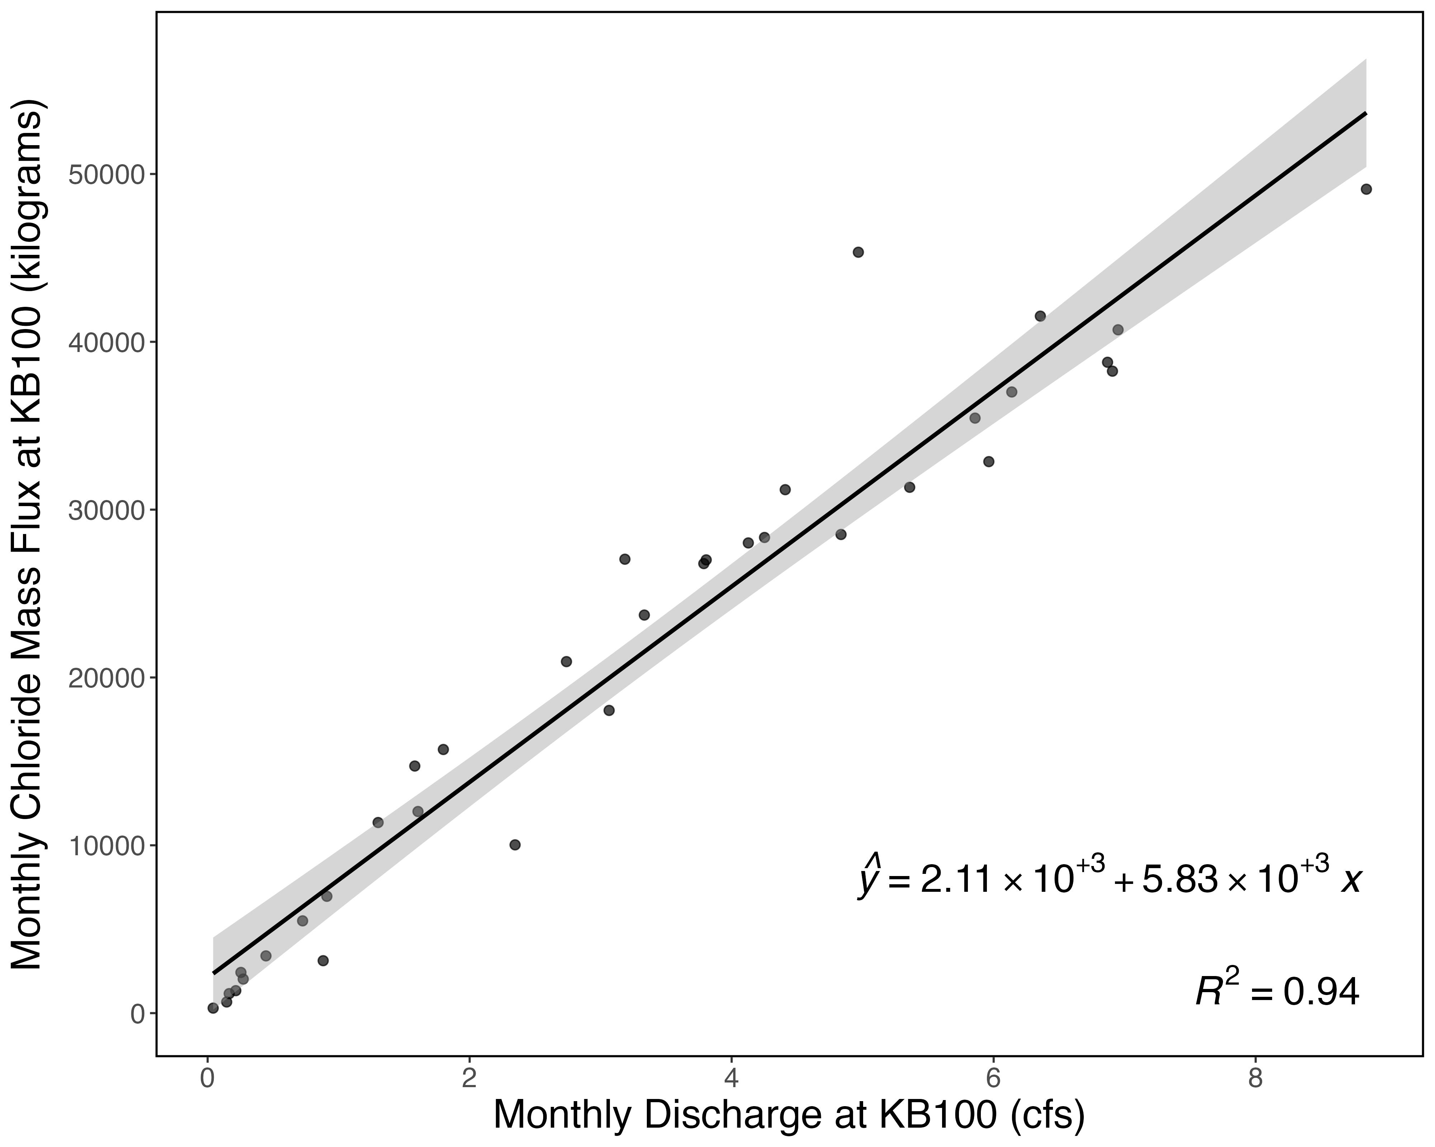
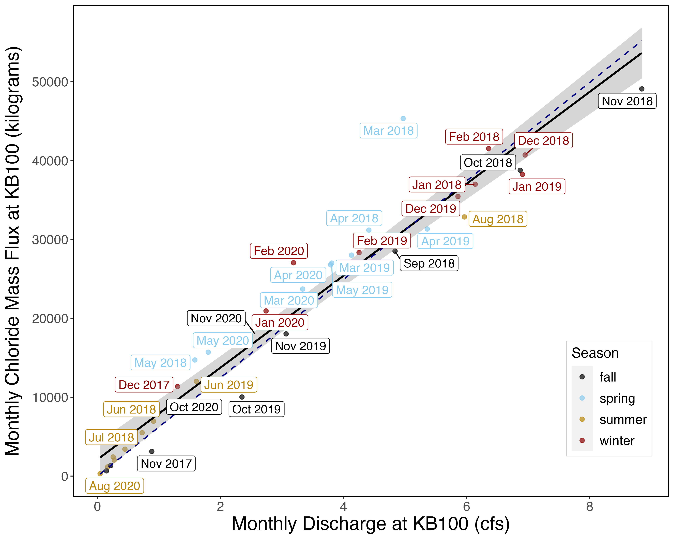
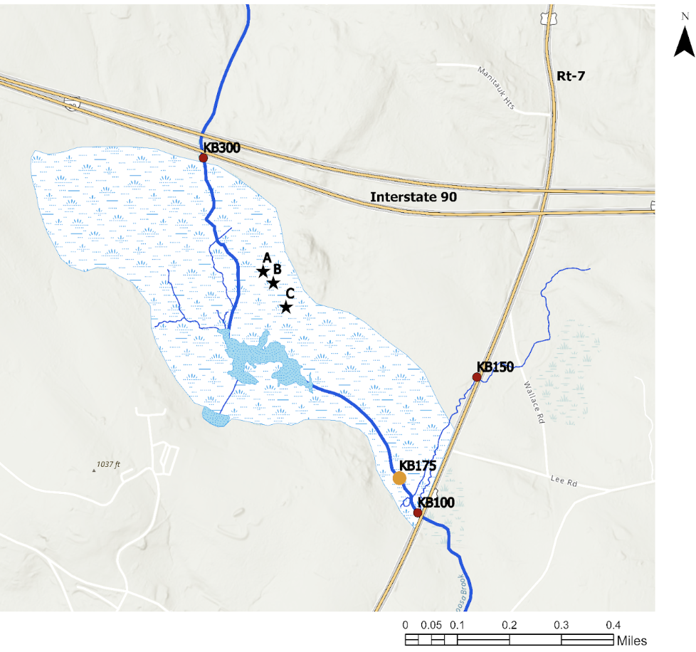
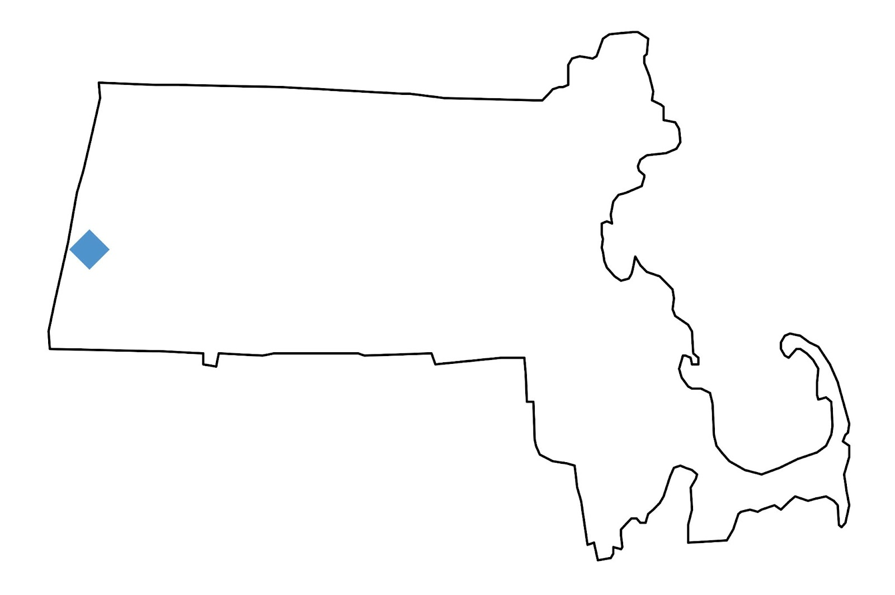
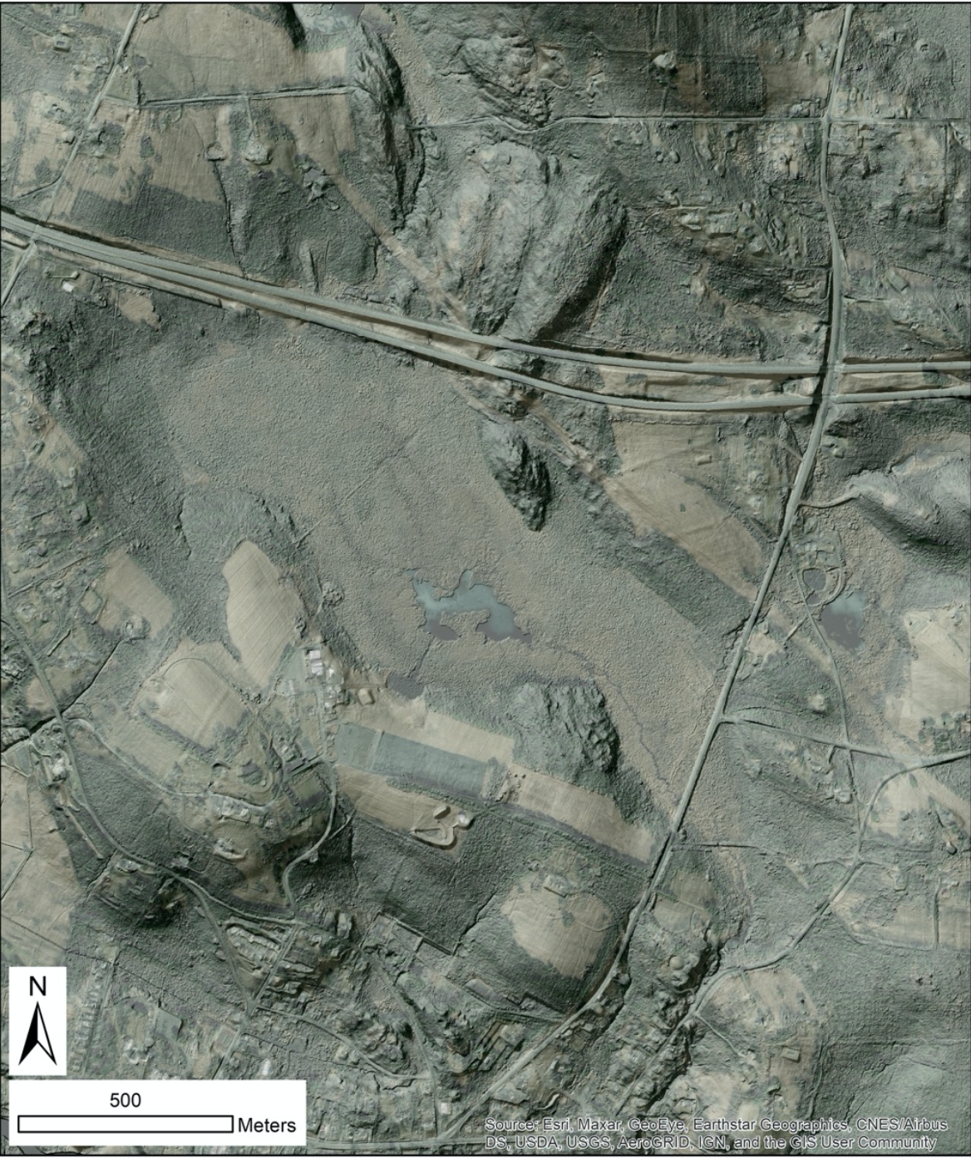
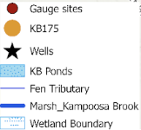
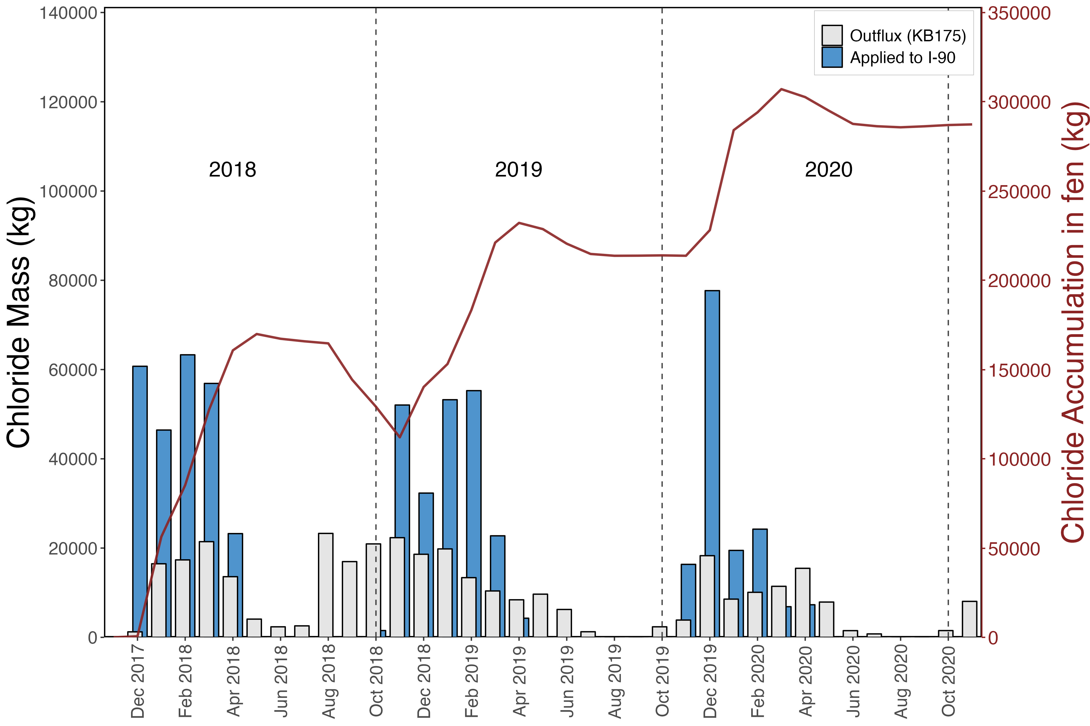
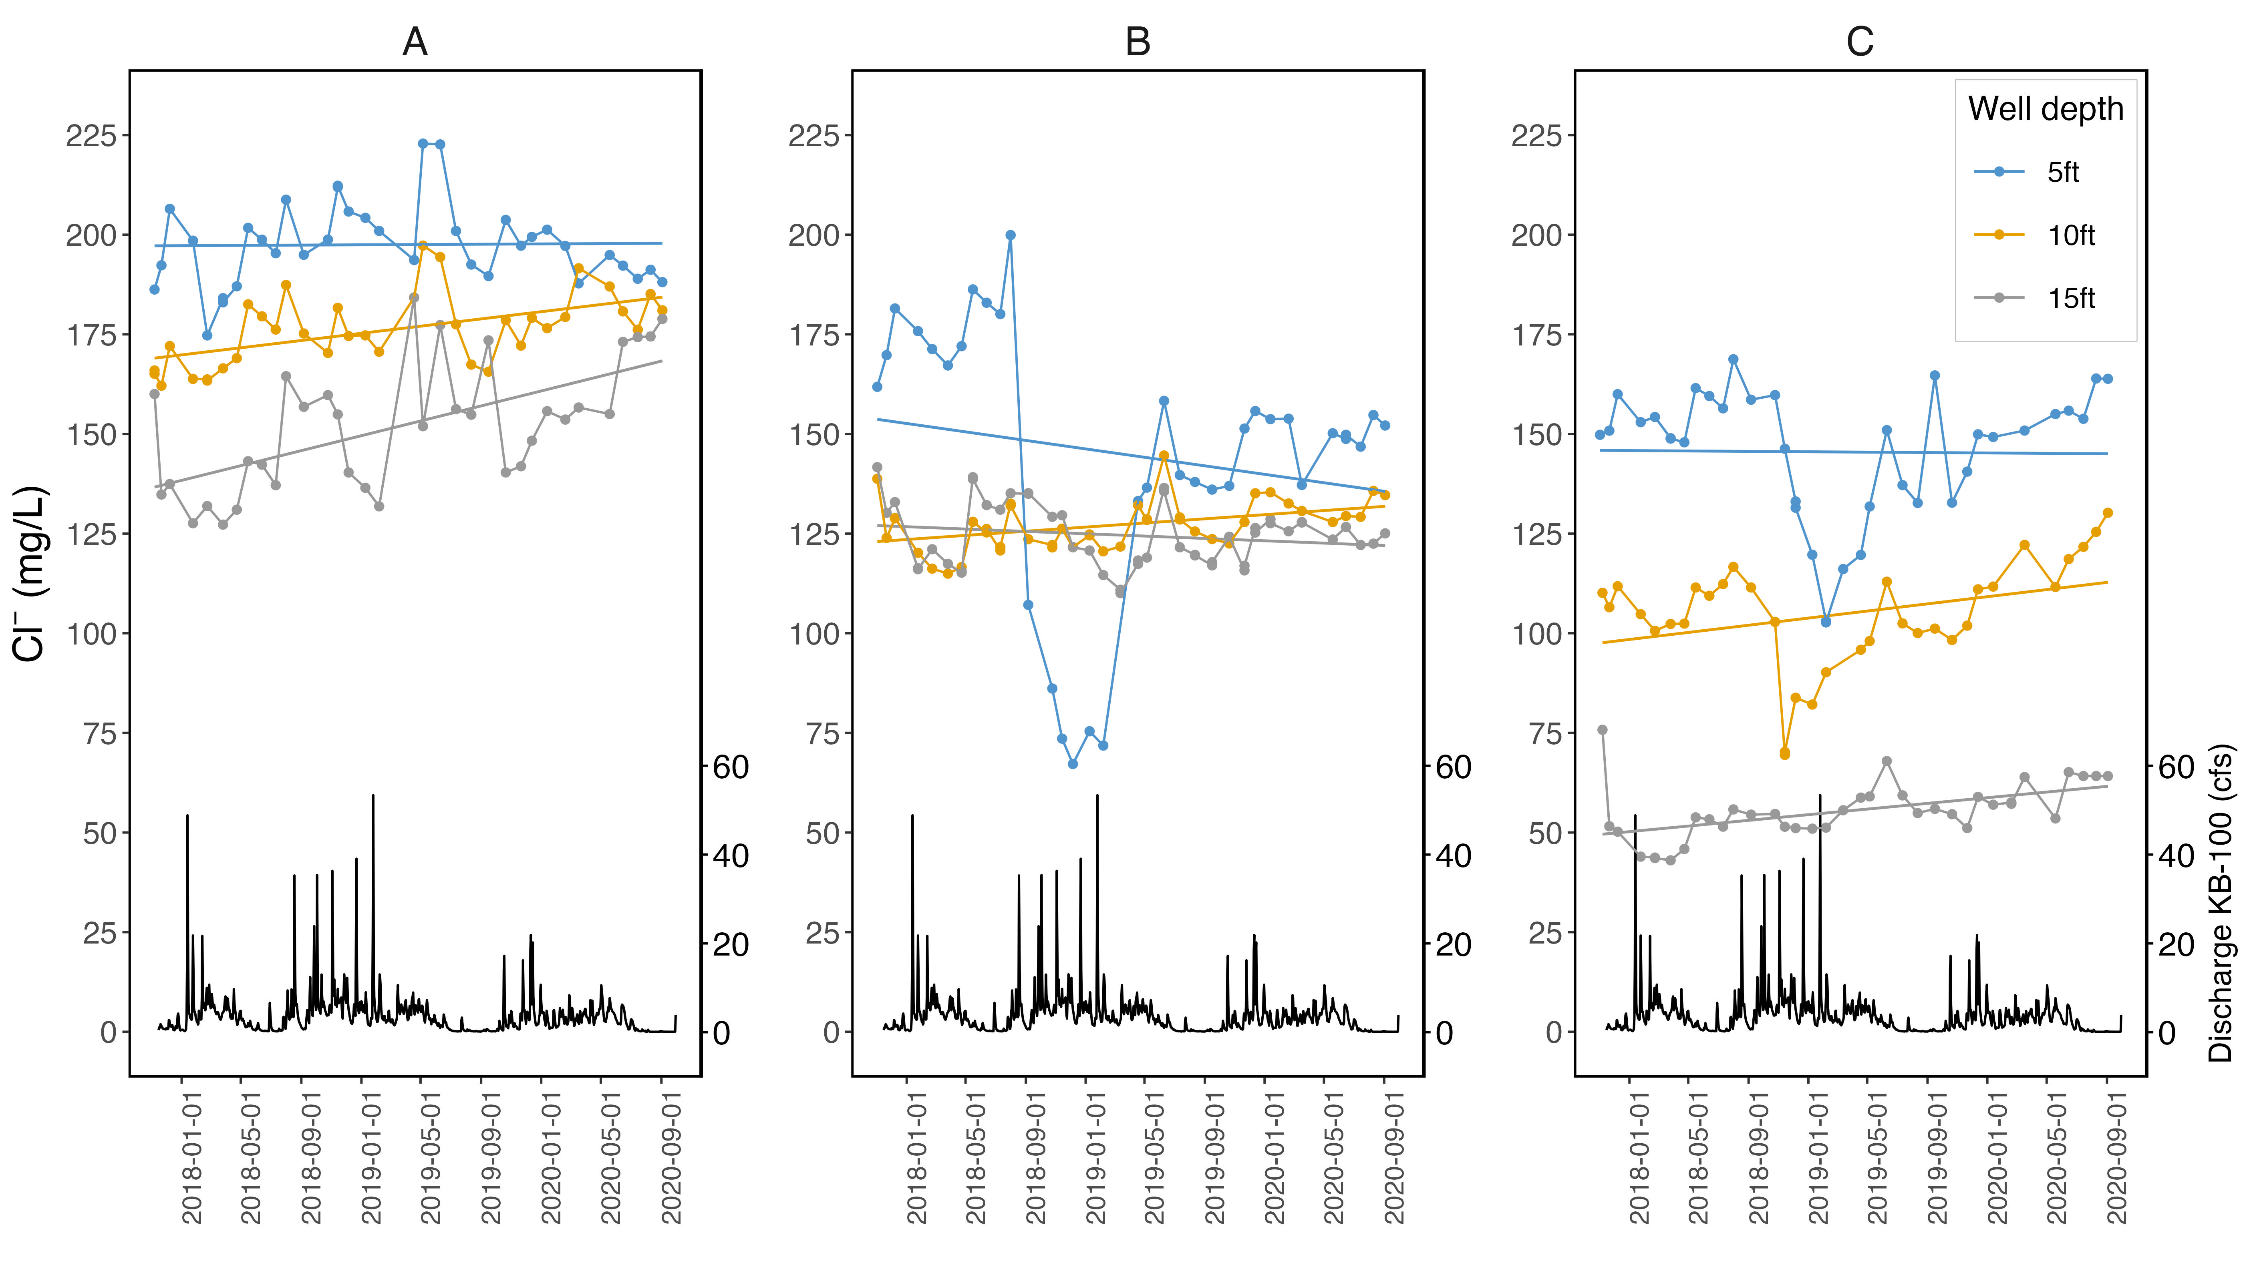
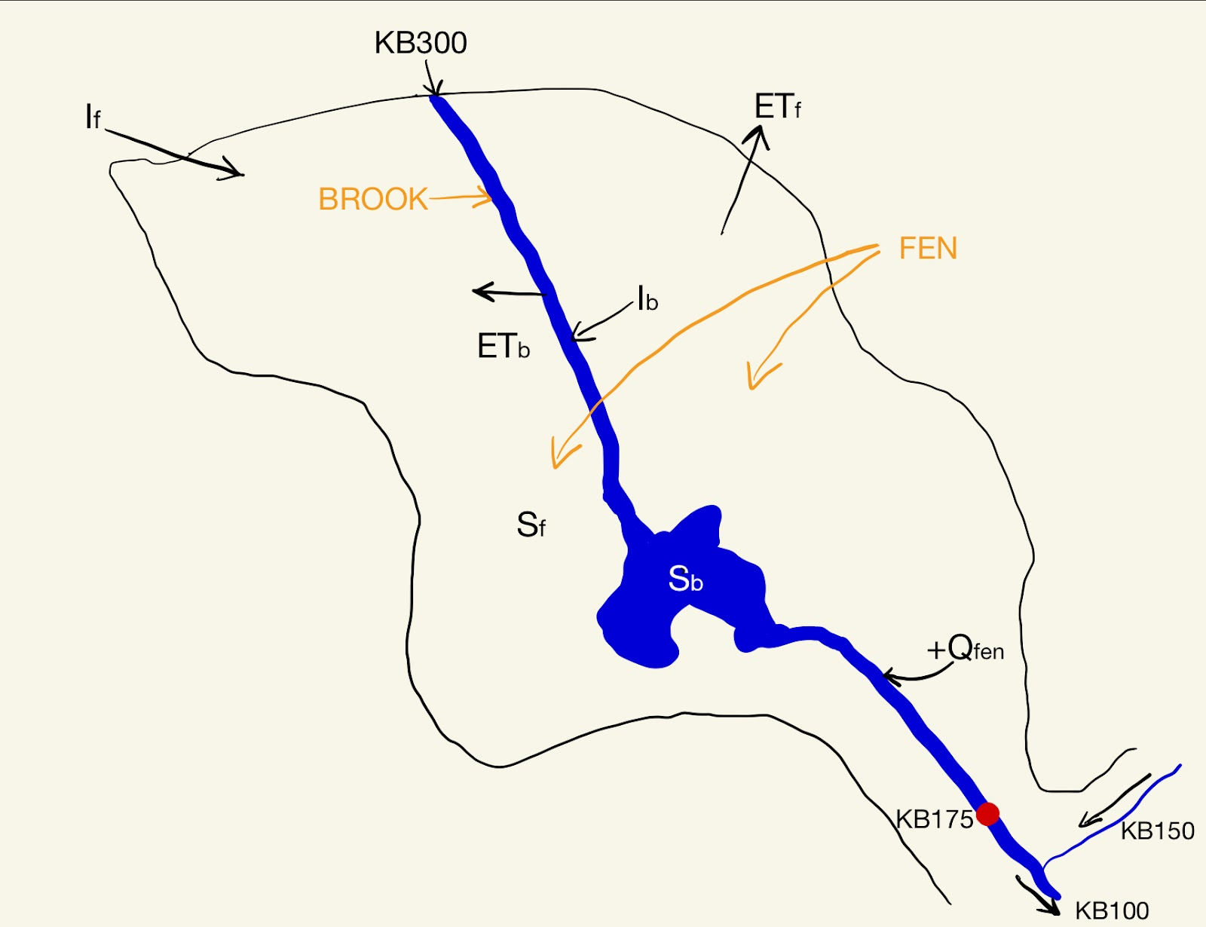
Accumulation of road salt in a calcareous fen: Kampoosa Bog, western Massachusetts
Wayne Ndlovu^{1,2}, Andrew Guswa³, Amy Rhodes¹
¹Department of Geosciences, Smith College, Northampton, MA 01063
²Geology Department, University of Kansas, Lawrence, KS 66044
³Picker Engineering Program, Smith College, Northampton, MA 01063
Road Salt Contamination at Kampoosa Bog
Key Findings:
Conditions for release of chloride from the fen
Road salt applied in the winter months leads to increased salinity levels in soils and water bodies.
High salinity at Kampoosa Bog has altered species diversity and lead to the abundance of salt tolerant plants and other invasives such as cattail and common reed.
Objectives:
Estimate chloride budget over a 3-year period (2017-2020) at Kampoosa Bog.
Determine conditions for storage and release of road salt in the fen.
There is a net accumulation of chloride in fen.
Increases in chloride concentrations are more pronounced at the deeper (10ft and 15ft) wells.
Chloride outflux is mainly driven by changes in discharge.
Next steps: More detailed wetland characterization to understand the different groundwater concentration patterns at well B.
High precipitation in fall 2018 coincide with high discharge chloride outflux at the outlets (KB-175 and KB-100).
Strong positive correlation between discharge and chloride mass flux at the Kampoosa Brook outlet point (KB-100).
Snow melt events lead to high discharge in the spring and summer months.
Annual Scale
Study Area:
Summary of hydrologic and chloride mass balances by water year for 2018 - 2020.
Kampoosa Bog is a 70 ha wetland complex located in a small watershed in Stockbridge and Lee, MA.
Primary inlet channel is the southern flowing Marsh Brook/Kampoosa Brook which flows under the turnpike before entering the bog.
 | Hydrology |  |  | Chloride Inputs |  | Chloride Exported |  | Chloride Accumulation
Water Year | Total Precipitation (inch) | Average Discharge KB300 (cfs) | Average Discharge KB175 (cfs) | Applied to 1.2 miles of I-90 (kg) | KB-300 Inlet (kg) | KB-175 Outlet (kg) | Average Flux Concentration KB175 (mg/L) | Fen Area (kg)
2018 | 46.9 | 0.8 | 2.1 | 251000 | 20500 | 119000 | 62.7 | 129000
2019 | 53.0 | 0.7 | 2.7 | 221000 | 14400 | 131000 | 54.9 | 85000
2020 | 46.8 | 0.5 | 1.4 | 152000 | 15100 | 80000 | 66.1 | 73000
Monthly chloride application, outflux and accumulation rates
5X vertical exaggeration
Groundwater Chloride Concentrations
Methods:
Concentrations vary with depth and distance from the Turnpike.
Dilution in the upper layers occurs during high discharge periods.
Concentrations increases at the 10ft and 15ft depths (A and C).
Estimated concentration increases given a total accumulation of 294000kg range from (54.0 – 36.0) mg/L for water depths of (10-15) ft.
Data Used:
Streamflow and specific conductance (SC) data for tributaries flowing in and out of the wetland. SC is used to calculate chloride concentrations.
Monthly groundwater and surface water chemistry data for 3 wells in the fen.
Monthly precipitation and air temperature data
Road salt application data for 1.2 mile stretch of Massachusetts Turnpike (I-90).
Monthly changes in salt storage fen
Salt_{fen} ^{j+1} = Salt_{fen} ^{j} + (Salt applied * 0.97) ^{j} + M_{KB300} ^{j} – M_{KB175} ^{j}
^{(j = month)}
Overall net chloride accumulation with greater accumulation rates during the winter.
Chloride outflux mainly occurs in the winter and spring months.
High chloride outflux in fall 2018.
Acknowledgements
Dr. Erich Hinlein and Dr. Camelia Rotoru (UMass Amherst)
Massachusetts Department of Transport
Tracy Tien (Smith College Spatial Analysis Lab); Will Hopper (Smith College – Statistical and Data Science)
Smith College McKinley, Tomlinson and SURF Funds
KB175 Watershed = 304ha

